Slide 2
Slavery in Islam & Christianity
By Sarah Lumgair (2019)

Slide 3
Intro on Slavery
Focus:
The muslim position
The christian position
Comparisons between the two
Notes:
In Bible & Quran
Emotive - (Used in Dawah, Sensitivities & Denials, Calls for reparation, Anger towards the church, Spin off religions narratives and groups in response)

Slide 4
First Things First…
What is slavery?
“Slavery is one of the things that everyone agrees is unethical.”
http://www.bbc.co.uk/ethics/slavery/ethics/intro_1.shtml
The Bible and the Qur’an use the terms slave and slavery in both positive and negative ways

Slide 5
Is a slave a thing or a person?
Notes:
In Bible & Quran
Emotive - (Used in Dawah, Sensitivities & Denials, Calls for reparation, Anger towards the church, Spin off religions narratives and groups in response)

Slide 6
First Things First…
Neutral Definition?
a person who is the property of and wholly subject to another; a bond servant
a person entirely under the domination of some influence or person
[http://dictionary.reference.com/browse/slave]

Slide 7
Classical Definitions
Aristotle & Roman Private Law
“Slaves… property, essentially no different than a farm implement or domesticated animal.”
Harrill. J, “The Manumission of Slaves in Early Christianity”, p14
Notes:
In Bible & Quran
Emotive - (Used in Dawah, Sensitivities & Denials, Calls for reparation, Anger towards the church, Spin off religions narratives and groups in response)

Slide 8
Orlando Patterson
Slavery is a process of dishonour, alienation, and “social death”
Concept of absolute power
Notes:
In Bible & Quran
Emotive - (Used in Dawah, Sensitivities & Denials, Calls for reparation, Anger towards the church, Spin off religions narratives and groups in response)

Slide 9
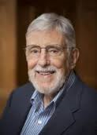
David Brion Davis
“The more we learn about slavery, the more difficulty we have defining it.”
Harrill. J, “The Manumission of Slaves in Early Christianity”, p15
Notes:
In Bible & Quran
Emotive - (Used in Dawah, Sensitivities & Denials, Calls for reparation, Anger towards the church, Spin off religions narratives and groups in response)

Slide 10
The Position of Cultural Anthropology Scholars:
"Scholars do not agree on a definition of "slavery”. The term has been used at various times for a wide range of institutions, including plantation slavery, forced labor, the drudgery of factories and sweatshops, child labor, semi-voluntary prostitution, bride-price marriage, child adoption for payment, and paid-for surrogate motherhood.
Somewhere within this range, the literal meaning of "slavery" shifts into metaphorical meaning, but it is not entirely clear at what point….."
[NS:ECA:4:1190f, Encyclopedia of Cultural Anthropology (4 vols), David Levinson and Melvin Ember (eds), HenryHolt:1996.]
Notes:
ANE (Ancient Near East)

Slide 11
Defining Slavery
Complete freedom to work and live where ever
Some sweatshop workers
Chattel slavery
Notes:
ANE (Ancient Near East)

Slide 12
The Muslim Position
Slavery is good as it is ordained by the Qur’an, and thus Allah
Slavery should not be practised today as there is no genuine caliphate
Islam came to abolish slavery
Notes:
In Bible & Quran
Emotive - (Used in Dawah, Sensitivities & Denials, Calls for reparation, Anger towards the church, Spin off religions narratives and groups in response)

Slide 13
Permitted Islamic Slavery
1. Prisoner of War
2. Born into slavery
All other forms abolished
Notes:
Outside of 6 books, 780 – 855AD

Slide 14
Status of a Humanity

Slide 15
Islam is diverse
Q30:22
And of His signs is the creation of the heavens and the earth and the diversity of your languages and your colors. Indeed in that are signs for those of knowledge. (quoted in ‘Day of Prayer’ this year, to prove there is diversity in the Qur’an)
Notes:
Outside of 6 books, 780 – 855AD

Slide 16
Islam is the religion of diversity
Q49:13
O mankind, indeed We have created you from male and female and made you peoples and tribes that you may know one another. Indeed, the most noble of you in the sight of Allah is the most righteous of you. Indeed, Allah is Knowing and Acquainted.
Notes:
Outside of 6 books, 780 – 855AD

Slide 17
Islam gives slaves equality
Q2:178
O you who have believed, prescribed for you is legal retribution for those murdered - the free for the free, the slave for the slave, and the female for the female. But whoever overlooks from his brother anything, then there should be a suitable follow-up and payment to him with good conduct. This is an alleviation from your Lord and a mercy. But whoever transgresses after that will have a painful punishment.
Notes:
Outside of 6 books, 780 – 855AD

Slide 18
Treatment of Slaves

Slide 19
Slaves are not to be beaten
Sahih Muslim, The Book of Oaths (Kitab Al-Aiman), Book 015, Number 4079
"Zadhan reported that Ibn Umar called his slave and he found the marks (of beating) upon his back. He said to him: I have caused you pain. He said: No. But he (Ibn Umar) said: You are free. He then took hold of something from the earth and said: There is no reward for me even to the weight equal to it. I heard Allah's Messenger (may peace be upon him) as saying: He who beats a slave without cognizable offence of his or slaps him, then expiation for it is that he should set him free.)"
Notes:
In Bible & Quran
Emotive - (Used in Dawah, Sensitivities & Denials, Calls for reparation, Anger towards the church, Spin off religions narratives and groups in response)

Slide 20
Slaves can be beaten
Abu Dawud, Book 004, Number 1814
Narated By Asma' bint Abu Bakr : We came out for performing hajj along with the Apostle of Allah (pbuh). When we reached al-Araj, the Apostle of Allah (pbuh) alighted and we also alighted. 'Aisha sat beside the Apostle of Allah (pbuh) and I sat beside my father (Abu Bakr). The equipment and personal effects of Abu Bakr and of the Apostle of Allah (pbuh) were placed with Abu Bakr's slave on a camel. Abu Bakr was sitting and waiting for his arrival. He arrived but he had no camel with him. He asked:
Where is your camel? He replied: I lost it last night. Abu Bakr said: There was only one camel, even that you have lost. He then began to beat him while the Apostle of Allah (pbuh) was smiling and saying: Look at this man who is in the sacred state (putting on ihram), what is he doing?
Notes:
In Bible & Quran
Emotive - (Used in Dawah, Sensitivities & Denials, Calls for reparation, Anger towards the church, Spin off religions narratives and groups in response)

Slide 21
Muhammad’s Slaves
Zayd & Zaynab

Slide 22
Zayd is freed from slavery
Al Tabari, Vol 39
At this, Muhammad took Zayd to the steps of the Kaaba, where legal contracts were agreed and witnessed, and announced to the crowds: “Witness that Zayd becomes my son, with mutual rights of inheritance.” On seeing this, Zayd’s father and uncle “were satisfied,” and they returned home without him.
Muhammad ibn Jarir al-Tabari, Tarikh al-Rusul wa’l-Muluk, vol. 39. Translated by Landau-Tasseron, E. (1998). Biographies of the Prophet’s Companions and Their Successors, p. 8-9. New York: State University of New York Press.
Notes:
In Bible & Quran
Emotive - (Used in Dawah, Sensitivities & Denials, Calls for reparation, Anger towards the church, Spin off religions narratives and groups in response)

Slide 23
Zayd becomes ‘Muhammad’s son’
Al Tabari, Vol 39
In accordance with the Arabic custom of adoption, Zayd was thereafter known as “Zayd ibn Muhammad” and was a freed man, regarded socially and legally as Muhammad’s son.
Muhammad ibn Jarir al-Tabari, Tarikh al-Rusul wa’l-Muluk, vol. 39. Translated by Landau-Tasseron, E. (1998). Biographies of the Prophet’s Companions and Their Successors, p. 9. New York: State University of New York Press.
Notes:
In Bible & Quran
Emotive - (Used in Dawah, Sensitivities & Denials, Calls for reparation, Anger towards the church, Spin off religions narratives and groups in response)

Slide 24
Q33:40
"Muhammad is not the father of any of your men, but (he is) the Messenger of Allah, and the Seal of the Prophets: and Allah has full knowledge of all things."
Notes:
In Bible & Quran
Emotive - (Used in Dawah, Sensitivities & Denials, Calls for reparation, Anger towards the church, Spin off religions narratives and groups in response)

Slide 25
This verse was revealed to help Muhammad out
Al Tabari, Vol 39
Q33:40 was revealed because "the Munafiqun made this a topic of their conversation and reviled the Prophet, saying 'Muhammad prohibits [marriage] with the [former] wives of one's own sons, but he married the [former] wife of his son Zayd.'"
Muhammad ibn Jarir al-Tabari, Tarikh al-Rusul wa’l-Muluk, vol. 39. Translated by Landau-Tasseron, E. (1998). Biographies of the Prophet’s Companions and Their Successors, p. 9. New York: State University of New York Press.
Notes:
The Munafiqun = the hypocrites

Slide 26
Zayd reverts to his original name
Al Tabari, Vol 39
Zayd reverted to being known by his original name of Zayd ibn Harithah and was no longer considered Muhammad's legal son after the revelation of Q33:40
Muhammad ibn Jarir al-Tabari, Tarikh al-Rusul wa’l-Muluk, vol. 39. Translated by Landau-Tasseron, E. (1998). Biographies of the Prophet’s Companions and Their Successors, p. 9-10. New York: State University of New York Press.

Slide 27
Muhammad can have slave women
Quran 33:50
“O Prophet, indeed We have made lawful to you your wives to whom you have given their due compensation and those your right hand possesses from what Allah has returned to you [of captives]…”
See also Q23:5-6, 4:24, 8:69

Slide 28
Freeing Slaves
Manumission

Slide 29
Emancipation of Slavery
The Emancipation Verse
Q24:33 – A slave can contract out of slavery
‘But let them who find not [the means for] marriage abstain [from sexual relations] until Allah enriches them from His bounty. And those who seek a contract [for eventual emancipation] from among whom your right hands possess - then make a contract with them if you know there is within them goodness and give them from the wealth of Allah which He has given you. And do not compel your slave girls to prostitution, if they desire chastity, to seek [thereby] the temporary interests of worldly life. And if someone should compel them, then indeed, Allah is [to them], after their compulsion, Forgiving and Merciful.’
Notes:
Outside of 6 books, 780 – 855AD

Slide 30
Legal Retribution
Often applied to abolition
Q8:67 – ‘Like with like’
O you who have believed, prescribed for you is legal retribution for those murdered - the free for the free, the slave for the slave, and the female for the female. But whoever overlooks from his brother anything, then there should be a suitable follow-up and payment to him with good conduct. This is an alleviation from your Lord and a mercy. But whoever transgresses after that will have a painful punishment.
Notes:
Outside of 6 books, 780 – 855AD

Slide 31
Guidance for Freeing Slaves
Q4:92 – Murder price = freed slave = 2 month fast
And never is it for a believer to kill a believer except by mistake. And whoever kills a believer by mistake - then the freeing of a believing slave and a compensation payment presented to the deceased's family [is required] unless they give [up their right as] charity. But if the deceased was from a people at war with you and he was a believer - then [only] the freeing of a believing slave; and if he was from a people with whom you have a treaty - then a compensation payment presented to his family and the freeing of a believing slave. And whoever does not find [one or cannot afford to buy one] - then [instead], a fast for two months consecutively, [seeking] acceptance of repentance from Allah . And Allah is ever Knowing and Wise.
Notes:
Outside of 6 books, 780 – 855AD

Slide 32
Guidance for Freeing Slaves
Q5:89 – Oath breaking = freed slave = 3 day fast
Allah will not impose blame upon you for what is meaningless in your oaths, but He will impose blame upon you for [breaking] what you intended of oaths. So its expiation is the feeding of ten needy people from the average of that which you feed your [own] families or clothing them or the freeing of a slave. But whoever cannot find [or afford it] - then a fast of three days [is required]. That is the expiation for oaths when you have sworn. But guard your oaths. Thus does Allah make clear to you His verses that you may be grateful.
Notes:
Outside of 6 books, 780 – 855AD

Slide 33
Muhammad’s Example
Freedom?

Slide 34
Example of Muhammad
The Abolitionist?
Sahih Bukhari - Volume 5, Book 57, Number 99:
Narrated Qais:
Bilal said to Abu Bakr, "If you have bought me for yourself then keep me (for yourself), but if you have bought me for Allah's Sake, then leave me for Allah's Work."
Notes:
Bilal was not freed by Muhammad, but by AbuBakr

Slide 35
Muhammad scolds a woman for freeing her slave
Sahih Bukhari - Volume 3, Book 47, Number 765:
Narrated Kurib:
“the freed slave of Ibn 'Abbas, that Maimuna bint Al-Harith told him that she manumitted a slave-girl without taking the permission of the Prophet. On the day when it was her turn to be with the Prophet, she said, "Do you know, O Allah's Apostle, that I have manumitted my slave-girl?" He said, "Have you really?" She replied in the affirmative. He said, "You would have got more reward if you had given her (i.e. the slave-girl) to one of your maternal uncles."

Slide 36
Muhammad re-enslaves freed slaves
The Abolitionist?
Sahih Muslim - Book 015, Number 4112:
'Imran b. Husain reported that a person who had no other property emancipated six slaves of his at the time of his death. Allah's Messenger called for them and divided them into three sections, cast lots amongst them, and set two free and kept four in slavery; and he (the Holy Prophet) spoke severely of him.

Slide 37
Muhammad cancels the manumission
The Abolitionist?
Sahih Bukhari - Volume 3, Book 41, Number 598:
Narrated Jabir: A man manumitted a slave and he had no other property than that, so the Prophet cancelled the manumission (and sold the slave for him). No'aim bin Al-Nahham bought the slave from him.

Slide 38
Muhammad redefines freedom
True Freedom?
Sahih Bukhari - Volume 8, Book 80, Number 753:
Narrated Anas bin Malik:
The Prophet said, "The freed slave belongs to the people who have freed him," or said something similar.

Slide 39
COLOURATION
Muhammad’s Views on
‘Black colour’

Slide 40
COLOURATION
The Farewell Sermon
Musnad Ahmad ibn Hanbal
“From Abi Nadrah: Someone who heard the sermon of the Messenger of Allah in the middle of the days of at-Tashriq narrated to me that he said, "O people! Indeed, your Lord is one and your father is one. Indeed, there is no superiority of an Arab over a non-Arab, nor of a non-Arab over an Arab, nor of a white over a black, nor a black over a white, except by taqwa. Have I conveyed the message?" They replied, "You have conveyed it, Messenger of Allah!"
Notes:
Outside of 6 books, 780 – 855AD

Slide 41
COLOURATION
The Farewell Sermon
Tabari, Vol 9, pp. 112-113
“…Listen to my words, O people, for I have conveyed the Message and understand [it]. Know for certain that every Muslim is a brother of another Muslim, and that all Muslims are brethren. It is not lawful for a person [to take] from his brother except that which he has given him willingly, so do not wrong yourselves. O Allah, have I not conveyed the message?”
Notes:
Outside of 6 books, 780 – 855AD

Slide 42
Muhammad:
Strong Views On ‘Black dogs’
Abu Dawud #2839
Abd Allah B. Mughaffal reported the apostle of Allah as saying: Were dogs not a species of creature I should command that they all be killed; but kill every pure black one.
The Hadith's note for #2839 says, "The prophet did not order the killing of all the dogs, for some are to be retained for hunting and watching. He ordered to kill the jet black ones. They might be more mischievous among them.
Notes:
In Bible & Quran
Emotive - (Used in Dawah, Sensitivities & Denials, Calls for reparation, Anger towards the church, Spin off religions narratives and groups in response)

Slide 43
Muhammad:
Black dogs are devils
Muslim Number 1032
Abd Dharr reported: The Messenger of 'Allah said: When any one of you stands for prayer and there is a thing before him equal to the back of the saddle that covers him and in case there is not before him (a thing) equal to the back of the saddle, his prayer would be cut off by (passing of an) ass, woman, and black Dog. I said: O Abu Dharr, what feature is there in a black dog which distinguish it from the red dog and the yellow dog? He said: O, son of my brother, I asked the Messenger of Allah as you are asking me, and he said: The black dog is a devil.
Notes:
In Bible & Quran
Emotive - (Used in Dawah, Sensitivities & Denials, Calls for reparation, Anger towards the church, Spin off religions narratives and groups in response)

Slide 44
Muhammad:
Black women cause epidemics
Bukhari Vol. 9, Book 87, Hadith 163
Narrated Salim's father
The Prophet said, "I saw (in a dream) a black woman with unkempt hair going out of Medina and settling in Mahai'a. I interpreted that as (a symbol of) epidemic of Medina being transferred to Mahai'a, namely, Al-Juhfa."
Notes:
In Bible & Quran
Emotive - (Used in Dawah, Sensitivities & Denials, Calls for reparation, Anger towards the church, Spin off religions narratives and groups in response)

Slide 45
Muhammad:
Anything but black
Sunan an-Nasa'i 5076
It was narrated that Jabir said:
"Abu Quhafah was brought on the Day of the Conquest of Makkah, and his hair and beard were white like the Thaghamah. The Messenger of Allah said: 'Change this with something, but avoid black.'"
Sahih
Notes:
In Bible & Quran
Emotive - (Used in Dawah, Sensitivities & Denials, Calls for reparation, Anger towards the church, Spin off religions narratives and groups in response)

Slide 46
COLOURATION
Piety
Sunan Ibn Maja: Vol 1
Do not marry women for their beauty, which may destroy them, or for their money, which may corrupt them, for religion. A slit-nosed black slave-woman, if pious, is preferable.
[Cairo, (1372/1952), p. 597]

Slide 47
COLOURATION
Emancipation Verse
Ibn Hazm (994-1064)
God has decreed that the most devout is the noblest even if he be a Negress’s bastard, and that the sinner and unbeliever is at the lowest level even if he be the son of the prophets.
[Ibn Hazm, “Jamharat Ansab al-Arab” Cairo, (1948)]

Slide 48
Ordered Society
Arab superiority

Slide 49
Ala Mawdudi
“Islam is not just a religion but a ‘revolutionary ideology and programme which seeks to alter the social order and rebuild it in conformity with its own tenets and ideals’.
Jihad in Islam, 3d ed. 1980, p.5
Notes:
In Bible & Quran
Emotive - (Used in Dawah, Sensitivities & Denials, Calls for reparation, Anger towards the church, Spin off religions narratives and groups in response)

Slide 50
Societal Order – 10th C.
Al- Tabari (839-923AD)
“Arabs are the most noble people in lineage, the most prominent, and the best in deeds. We were the first to respond to the call of the Prophet. We are Allah’s helpers and the viziers of His Messenger. We fight people until they believe in Allah. He who believes in Allah and His Messenger has protected his life and possessions from us. As for one who disbelieves, we will fight him forever in Allah’s Cause. Killing him is a small matter to us.”
Notes:
In Bible & Quran
Emotive - (Used in Dawah, Sensitivities & Denials, Calls for reparation, Anger towards the church, Spin off religions narratives and groups in response)

Slide 51
Societal Order – 14th C.
Ibn Taymiyyah (1263-1328AD)
"A man married a maid-slave who bore him a child. Would that child be free or would he be an owned slave?" "Her child whom she bore from him would be the property of her master according to all the Imams (heads of the four Islamic schools of law) because the child follows the (status) of his mother in freedom or slavery. If the child is not of the race of Arabs, then he is definitely an owned slave according to the scholars, but the scholars disputed (his status) among themselves if he was from the Arabs - whether he must be enslaved or not because when A'isha (Muhammad's wife) had a maid-slave who was an Arab, Muhammad said to A'isha, `Set this maid free because she is from the children of Ishmael [Arab].'“
Vol. 1, p12
Notes:
In Bible & Quran
Emotive - (Used in Dawah, Sensitivities & Denials, Calls for reparation, Anger towards the church, Spin off religions narratives and groups in response)

Slide 52
What Happened Just Before the Trans-Atlantic
Slave Trade?
Pre-1400

Slide 53
Ibn Qutaybah
Al-Muqaddasi
Nasir al-Din al-Tusi
Jan 1
Jan 1
Jan 1
Al-Jahiz
Al-Tabari
Ibn Sina
Ibn Taymiyyah
Ibn Khaldun
Jan 1
Jan 1
Jan 1
Jan 1
Jan 1
0869
869
918
967
1016
1065
1114
1163
1212
1261
1310
1359
1407
Today

Slide 54
Societal Order – 9th C.
Al-Jahiz (781-869AD) [Famous Muslim scholar]
"We know that the Zanj (blacks) are the least intelligent and the least discerning of mankind, and the least capable of understanding the consequences of actions.“
[Jahiz, Kitab al-Bukhala (“Avarice and the Avaricious”)]
Notes:
Famous Muslim scholar

Slide 55
Societal Order – 9th C.
Al-Jahiz (781 – 869 AD) [Famous Muslim scholar]
"They [the Shu`ubiyya] maintain that eloquence is prized by all people at all times - even the Zanj, despite their dimness, their boundless stupidity, their obtuseness, their crude perceptions and their evil dispositions, make long speeches.”
[Jahiz, Al-Bayan wa`l-tabyin, vol. 3]
Notes:
Famous Muslim scholar

Slide 56
Societal Order – 9th C.
Al-Jahiz (781-869AD)
"Like the crow among mankind are the Zanj [African Blacks] for they are the worst of men and the most vicious of creatures in character and temperament.”
[Jahiz, Kitab al-Hayawan, vol. 2]
Notes:
Famous Muslim scholar

Slide 57
Societal Order – 9th C.
Ibn Qutaybah (828-889AD) [Renowned Islamic scholar from Kufa, Iraq]
“[Blacks] are ugly and misshapen, because they live in a hot country.”
[Adam Misbah al-Haqq “Blasphemy Before God: The Darkness of Racism in Muslim Culture”]
Notes:
Renowned Islamic scholar from Kufa, Iraq

Slide 58
Societal Order – 11th C.
Al-Muqaddasi (945/946-1000AD) [Medieval Muslim geographer]
"Of the neighbors of the Bujja, Maqdisi had heard that "there is no marriage among them; the child does not know his father, and they eat people -- but God knows best. As for the Zanj, they are people of black colour, flat noses, kinky hair, and little understanding or intelligence.“
[Kitab al-Bad’ wah-tarikh]
Notes:
Medieval Muslim geographer

Slide 59
Societal Order – 11th C.
Ibn Sina (980-1037AD) [Hafiz, Islamic psychologist, Islamic scholar, theologian]
“[Blacks are] people who are by their very nature slaves.
[Adam Misbah al-Haqq “Blasphemy Before God: The Darkness of Racism in Muslim Culture”]
Notes:
Hafiz, Islamic psychologist, Islamic scholar, theologian

Slide 60
Societal Order – 13th C.
Nasir al-Din al-Tusi (1201-1274AD) [Shia Muslim Scholar and Grand Ayatollah]
"If (all types of men) are taken, from the first, and one placed after another, like the Negro from Zanzibar, in the Southern-most countries, the Negro does not differ from an animal in anything except the fact that his hands have been lifted from the earth -in no other peculiarity or property - except for what God wished. Many have seen that the ape is more capable of being trained than the Negro, and more intelligent.“
Tasawwurat (Rawdat al-taslim)
Notes:
Shia Muslim Scholar and Grand Ayatollah

Slide 61
Societal Order – 14th C.
Ibn Khaldun (1332-1406AD) [Islamic Jurist, Islamic lawyer, scholar, theologian, and hafiz]
"Therefore, the Negro nation are, as a rule, submissive to slavery, because [Negroes] have little [that is essentially] human and have attributes that are quite similar to those of dumb animals, as we have stated.“
"beyond [known peoples of black West Africa] to the south there is no civilization in the proper sense. There are only humans who are closer to dumb animals than to rational beings. They live in thickets and caves, and eat herbs and unprepared grain. They frequently eat each other. They cannot be considered human beings."
Notes:
Islamic Jurist, Islamic lawyer, scholar, theologian, and hafiz

Slide 62
Appropriate Worth
Edward William Lane on Egyptian slavery
“The price of a white slave-girl is usually from treble to tenfold that of an Abyssinian: and the price of a black girl, about half or two-thirds, or considerably more if well instructed in the art of cookery. The black slaves are generally employed as menials.”
Lane, E. W. “An Account of the Manners and Customs of the Modern Egyptians” 5th ed. Vol. 1, pp. 233-34
Notes:
Famous Muslim scholar

Slide 63
Colourism & Islam

Slide 64
Appearance of Muhammad
Handsome White Face
Muslim 2340
White Man
Bukhari 1:3:63
White Forearm
Dawud 3206
White Armpits
Bukh. 8:78:631
White Abdomen/Belly
Bukh. 4:56:767
White Leg/Shank
Bukh. 4:56:767
White Skin
Al-Adab Mufra 790:33:37

Slide 65
Appearance of Muhammad
Ibn Musa al-Yahsunbi
Anyone who says that the Prophet was black should be killed.
Not completely white
Bukhari 4:56:744

Slide 66
Pre-Islamic Views on Colour
Pre-Islamic Literature
“The Arabs…sometimes describe themselves as black in contrast to Persians, who are red, but at other times as red or white in contrast with Africans, who are black. The characteristic colour of the Bedouin is variously stated as olive or brown”.
[Bernard Lewis “Race and Slavery in the Middle East”, p. 22]

Slide 67
Treatment of Slaves
Colourism
Bernard Lewis:
“During the period immediately following the death of the Prophet in 632 AD the great Islamic conquests took the new faith to vast areas of Asia and also to Africa. A new situation was created, and many changes can be observed in the literature of the time.”
“The first of these is the narrowing, specializing, and fixing of colour terms applied to human beings. In time, almost all disappear apart from “black”, “red”, and “white”; and these become ethnic and absolute instead of personal and relative….”
Notes:
In Bible & Quran
Emotive - (Used in Dawah, Sensitivities & Denials, Calls for reparation, Anger towards the church, Spin off religions narratives and groups in response)

Slide 68
Treatment of Slaves
Colourism
Bernard Lewis:
“…Together with this specialization and fixing of colour terms comes a very clear connotation of inferiority attached to darker and more specifically black skins.”
“Race and Slavery in the Middle East – An Historical Enquiry”, pg 26]
Notes:
In Bible & Quran
Emotive - (Used in Dawah, Sensitivities & Denials, Calls for reparation, Anger towards the church, Spin off religions narratives and groups in response)

Slide 69
Colourism in early African Muslim literature

Slide 70
Attitudes in Literature
Early Islamic Period
African Origin Poet, Suhaym – 660 AD
“If my colour were pink, women would love me
But the Lord has marred me with blackness”
“Though I am a slave my soul is nobly free
Though I am black of colour my character is white”
“I am covered with a black garment, but under it there
is a lustrous garment with white skirts”
[Suhaym, Diwan p, 69]

Slide 71
Attitudes in Literature
Acceptance of Inferiority
Black Poet, Abu Dulama “Father of Blackness” – 776 AD [Probably the best known early black poet in Arabic. A Slave who became a court jester of the 1st Abbasid caliphs]
“We are alike in colour; our faces are black and
Ugly, our names are shameful.”
[Mohammed Ben Cheneb, Abu Dolama, poete bouffon de la cour des premiers calies abbasides (Algiers, 1992), pp 35, 136]
Notes:
Probably best known early black poets in Arabic. Slave who became court jester of 1st abbasid caliphs

Slide 72
Attitudes in Literature
Question of Blackness
Jahiz of Basra, 776-869 AD
[One of greatest prose writers in classical Arabic literature and may be partly of African descent. In his sppecial essay “the Boast of the Blacks against the Whites”]
“It is part of your ignorance… that in the time of heathendom [ i.e., in pre-Islamic Arabia] you regarded us [blacks] as good enough to marry your women, yet when the justice of Islam came, you considered this wrong.”
[Pellat, “The Life and Works of Jahiz”, pp. 195-198]
Notes:
One of greatest prose writers in classical Arabic literature and may be partly Afican descendent. Special essay “the Boast of the Blacks against the Whites”

Slide 73
Colourism in the Qur’an & Hadith

Slide 74
Bernard Lewis
“… black [in Islam] is somehow connected with sin, evil, deviltry and damnation, while white has the opposite associations.”

Slide 75
Q3:106
“On the Day (i.e. the Day of Resurrection) when some faces will become white and some faces will become black; as for those whose faces will become black (to them will be said): "Did you reject Faith after accepting it? Then taste the torment (in Hell) for rejecting Faith."

Slide 76
Q39:60
“And on the Day of Resurrection you will see those who lied about Allah [with] their faces blackened. Is there not in Hell a residence for the arrogant?"

Slide 77
Colourism in the Hadith
Jami at-Tirmidhi: Vol. 2, Bk 4, No 877
Ibn Abbas narrated that:
“The Messenger of Allah said: "The Black Stone descended from the Paradise, and it was more white than milk, then it was blackened by the sins of the children of Adam."

Slide 78
Bukhari Vol. 9, Book 89, Hadith 256
Narrated Anas bin Malik:
Allah's Messenger said, "You should listen to and obey, your ruler even if he was an Ethiopian (black) slave whose head looks like a raisin.
Notes:
In Bible & Quran
Emotive - (Used in Dawah, Sensitivities & Denials, Calls for reparation, Anger towards the church, Spin off religions narratives and groups in response)

Slide 79
Sunan an-Nasa'i 4184
It was narrated that Jabir said:
"A slave came and pledged to the Prophet to emigrate, and the Prophet did not realize that he was a slave. Then his master came looking for him. The Prophet said: 'Sell him to me,' and he bought him for two black slaves. Then he did not accept the pledge from anyone until he asked: 'Is he a slave?"‘
Sahih (Darussalam)
Notes:
In Bible & Quran
Emotive - (Used in Dawah, Sensitivities & Denials, Calls for reparation, Anger towards the church, Spin off religions narratives and groups in response)

Slide 80
Treatment of Black Slaves

Slide 81
Treatment of Slaves
Black Slaves
Dr. John Azumah notes:
“In areas like North Africa, the Middle East and Turkey, black slaves did the meanest and hardest work…”
“The first-generation and plantation slaves in Muslim lands was as harsh and cruel as any other such system, while successive generations of all slaves had to live under the weight and stigma of racial and social discrimination.”
[Azumah, “The Legacy of Arab-Islam in Africa”, 156, 162]
Notes:
In Bible & Quran
Emotive - (Used in Dawah, Sensitivities & Denials, Calls for reparation, Anger towards the church, Spin off religions narratives and groups in response)

Slide 82
Treatment of Slaves
Black Slaves
Al Tabari (10th century) notes:
Zanj employed in groups (500-5000)
Salt marshes of southern Iraq
Their condition was ‘extremely bad’, and they were ‘literally pinned down there, hopeless and homeless’
The bad treatment led to numerous slave revolts, beginning in 689AD.
[Oseni, ‘The Revolts of Black Slaves on Iraq’, 58]
Notes:
In Bible & Quran
Emotive - (Used in Dawah, Sensitivities & Denials, Calls for reparation, Anger towards the church, Spin off religions narratives and groups in response)

Slide 83
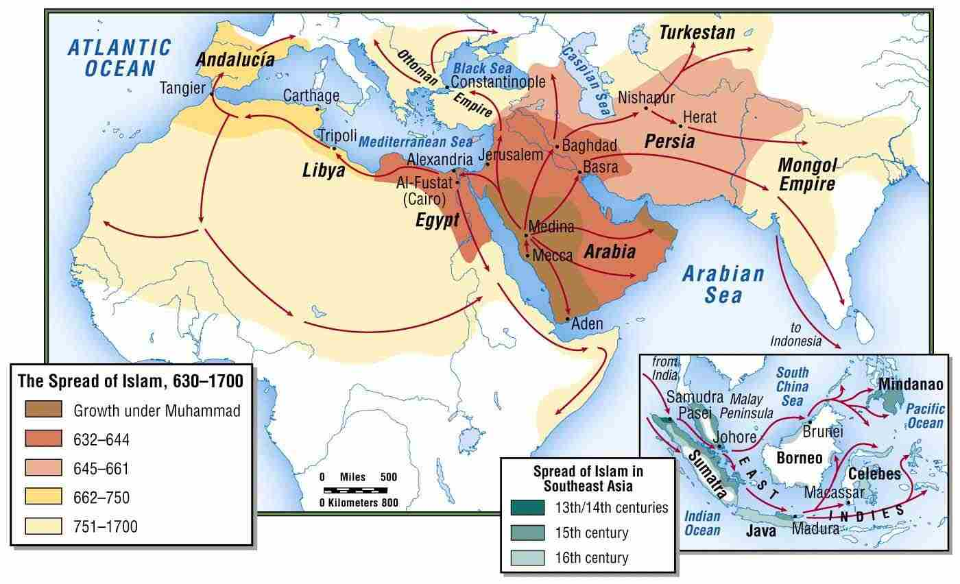
From 639 AD
Arab Conquest into Africa & Asia
Notes:
Accomplished by one of two methods: (1) Revision of genealogy so that North Africans, whilst still sons of Ham, descended through a son other than Canaan, or (2) story retold so that these Sons of Ham were forgiven the sin of their ancester

Slide 84
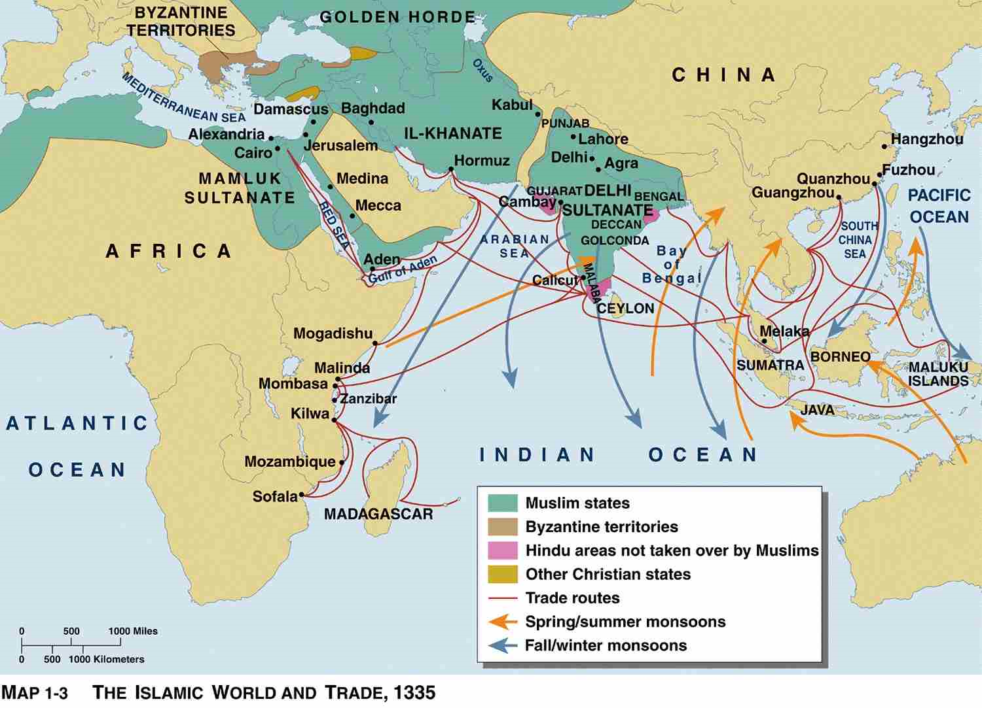
From 639 AD
Trade Routes from Africa to Asia
Notes:
Accomplished by one of two methods: (1) Revision of genealogy so that North Africans, whilst still sons of Ham, descended through a son other than Canaan, or (2) story retold so that these Sons of Ham were forgiven the sin of their ancester

Slide 85
Where Did This All Come From?

Slide 86
Curse of Ham
Historian, David Goldenberg, states:
“…in the seventh century, we begin to see the expressions banu ham (Arabic) and bnei ham (Hebrew) being used as synonyms for “black African”.
[Goldenberg, “The Curse of Ham” pp. 166-167]
Notes:
At this time, for most Arabs “slave” (abdun) meant black, European slaves were call mamluks, The Banu Ham (Sons of Ham) were Sudan (Blacks or Negroes)

Slide 87
Curse of Ham
Historian, Rotter, states:
“…during the first three Islamic centuries banu Ham appears quite often as a synonym for a black African.
[Rotter, “Die Stellung des Negers” p. 141]
Notes:
At this time, for most Arabs “slave” (abdun) meant black, European slaves were call mamluks, The Banu Ham (Sons of Ham) were Sudan (Blacks or Negroes)

Slide 88
Curse of Ham
Historian, David Goldenberg, states:
“We first see this… explicit link between skin colour and slavery in Near Eastern sources beginning in the seventh century.”
“The tradition that Noah uttered a dual curse against his son Ham, cursing him with blackness and with slavery at the same time, is very widespread in Islamic sources.”
[Goldenberg, “The Curse of Ham” pp. 170]
Notes:
At this time, for most Arabs “slave” (abdun) meant black, European slaves were call mamluks, The Banu Ham (Sons of Ham) were Sudan (Blacks or Negroes)

Slide 89
Curse of Ham
David Goldenberg also found versions of the Curse of Ham in these Muslim sources:
Ibn Ata (647-732)
“Ham begat all those who are black and curly-haired….Noah prayed that the hair of Ham’s descendants would not grow beyond their ears, and that wherever his descendants met the children of Shem, the latter would enslave them.”
[Goldenberg, “Curse of Ham,” 33]

Slide 90
Curse of Ham
Tabari, 923AD:
“Ham begat all those who are black and curly-haired… Noah prayed that the hair of Ham’s descendants would not grow beyond their ears, and that wherever his descendants met the children of Shem, the latter would enslave them”.
[Brinner, “The History of al-Tabari” 1:223]
Notes:
At this time, for most Arabs “slave” (abdun) meant black, European slaves were call mamluks, The Banu Ham (Sons of Ham) were Sudan (Blacks or Negroes)

Slide 91
Curse of Ham
Ibn Khaldun, 13th Century:
Notes and disagrees with the opinion:
“Negroes are the children of Ham, the son of Noah, and …they were singled out to be black as the result of Noah’s curse, which produced Ham’s colour and the slavery God inflicted upon his descendants”.
Rosenthal, F. “Ibn Khaldun: The Muqaddimah” 2nd ed. (1967) pp. 171-172
Notes:
At this time, for most Arabs “slave” (abdun) meant black, European slaves were call mamluks, The Banu Ham (Sons of Ham) were Sudan (Blacks or Negroes)

Slide 92
Curse of Ham
Midrash on Genesis (5th Century)
“R[abbi] Huna said in R[abbi] Joseph’s name (Noah declared), “you have prevented me from begetting a fourth son, therefore I curse your fourth son.” R[abbi] Huna also said in R[abbi] Joseph’s name: “You have prevented me from doing something in the dark (…cohabitation), therefore your seed will be ugly and dark-skinned. “R[abbi] Hiyya said: “Ham and the dog copulated in the Ark, therefore Ham came black-skinned while the dog publicly exposes his copulation.”
Freedman and Simon, Midrash Rabbah: Genesis, chap. 36

Slide 93
Curse of Ham
Babylonian Talmud (6th Century)
“Our Rabbis taught: ‘Three copulated in the ark, and they were all punished – the dog, the raven, and Ham. The dog was doomed to be tied, the raven expectorates [her seed into his mate’s mouth], and Ham was smitten in his skin.”
[Epstein, Hebrew-English Edition of the Babylonian Talmud, tractate Sanhedrin 108b]

Slide 94
Curse of Ham
Quotes so far:
“Ham became black-skinned”
“Ham was smitten in his skin”
Genesis 9:25
“Cursed be Canaan;
a servant of servants shall he be to his brothers.”
What is wrong with these quotes?

Slide 95
Curse of Ham
Genesis 9:22-25
²² And Ham, the father of Canaan, saw the nakedness of his father and told his two brothers outside. ²³ Then Shem and Japheth took a garment, laid it on both their shoulders, and walked backward and covered the nakedness of their father. Their faces were turned backward, and they did not see their father's nakedness. ²⁴ When Noah awoke from his wine and knew what his youngest son had done to him, ²⁵ he said,
“Cursed be Canaan; a servant of servants shall he be to his brothers.”
Notes:
Slave wages, slave property, slave justice

Slide 96
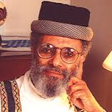
Curse of Ham
Ethiopian scholar, Ephraim Isaac:
“In Rabbinic literature, we do not have or find an implication that the descendants of the accursed Canaan are black or African People. Indeed there was never a question in Rabbinic thought – it was Cush and not Canaan who inhabited Africa south of Egypt.”
[Isaac, “Genesis, Judaism” (1985), 77]

Slide 97
Curse of Ham
Jewish scholar, David Goldenberg:
“The claim that two aggadic folktales, representing .0006 percent of the overall Talmudic corpus and transmitted by two of 1500 personalities, represents ‘the Talmudic view’ sounds a little ridiculous.”
[Goldenberg, “Curse of Ham,” 32, idem, “Image of the
Black in Jewish Culture,” 557-79]

Slide 98
How Did These Attitudes, Not in the Bible, Get Into Islam?

Slide 99
Curse of Ham
The Cave of Treasures
Ephraim the Syrian 373AD
“… And Canaan was cursed because he had dared to do this, and his seed became a servant of servants, that is to say, to the Egyptians, and the Cushites, and the Mûsâyê (Mysians), [and the Indians, and all the Ethiopians, whose skins are black]. And because Ham had dared to make a mock of his father he was called "vile" (or "lascivious") all the days of his life.”
[Fol. 19a, col. 1 – Fol. 20a, col. 1]
Notes:
Accomplished by one of two methods: (1) Revision of genealogy so that North Africans, whilst still sons of Ham, descended through a son other than Canaan, or (2) story retold so that these Sons of Ham were forgiven the sin of their ancester

Slide 100
From 639 AD
Arab Conquest into Africa
Important note:
There is very little evidence of slaves raids in Africa before Muslim involvement.
An Ashanti ruler stated:
‘I cannot make war to catch slaves in the bush like a thief. My ancestors never did so.’
[I. Wilks, ‘Asante in the Nineteenth Century’, 176]
Notes:
Accomplished by one of two methods: (1) Revision of genealogy so that North Africans, whilst still sons of Ham, descended through a son other than Canaan, or (2) story retold so that these Sons of Ham were forgiven the sin of their ancester

Slide 101
7th Century: The Baqt
Baqt of 652AD
Agreement made between Muslim Egypt and Christian Nubia, requiring Nubia to supply 360 slaves annually to Egypt.
In addition to the 360, another 40 were sent annually, either for the Arab officials handling the transaction, to compensate for an estimated 10% loss during transport.
[Hasan, ‘The Penetration of Islam’, 113-115; Lokkegaard “EI”; Ootto Meinadus, “The Christian Kingdoms of Nubia” [1967, p146]

Slide 102
Curse of Ham/Canaan
Historian, David Brion Davis, comments that by the 8th and 9th centuries, Arab writers
“…increasingly invoked the biblical curse of Canaan to explain why the ‘sons of Ham’ had been blackened and degraded to the status of natural slaves as punishment for their ancestor’s sin”.
[Davis, “Slavery and Human Progress” 42]
Notes:
At this time, for most Arabs “slave” (abdun) meant black, European slaves were call mamluks, The Banu Ham (Sons of Ham) were Sudan (Blacks or Negroes)

Slide 103
Curse of Ham
William Evans, observes that by the 10th century the curse had been modified to exempt Egyptians and Berbers.
[Evans, “From the land of Canaan” 33]
Notes:
Accomplished by one of two methods: (1) Revision of genealogy so that North Africans, whilst still sons of Ham, descended through a son other than Canaan, or (2) story retold so that these Sons of Ham were forgiven the sin of their ancester

Slide 104
Arab-Islamic Slave Raids: Pre-Cursor to Trans-Atlantic Slave Trade?

Slide 105
Curse of Ham/Canaan
Edwin Yamauchi concludes:
“… we see that over the centuries an obscure text was so interpreted by medieval Jews to explain the blackness of Africans and was then used in turn by Arabs, Europeans, and North Americans to justify slavery and, until recently, by Mormons to exclude blacks from their priesthood.”
[Yamauchi, “Africa and the Bible” (1985), 31]

Slide 106
Bernard Lewis
“The myth of Islamic racial innocence was a Western creation and served a Western purpose… In the [18th] century, the philosophers of the Enlightenment had praised Islam for its lack of dogmas and mysteries, its freedom from priests and Inquisitors and other persecutors – recognising real qualities but exaggerating them as a polemical weapon against the Christian churches and clergy.”
Lewis. Bernard, “Race and Slavery in the Middle East”, (1990) p101

Slide 107
Davis Goldenberg
“Lewis did not find anti-Black sentiment in Arabia until the seventh-century conquest of Africa and the enslavement of its inhabitants. Snowden and Thompson similarly did not find a prejudiced view of Blacks in ancient Greece and Rome…. In those earlier times colour did not define a person and was not a criterion for categorizing humanity.”
Goldenberg, D “The Curse of Ham” (2003), p. 200

Slide 108
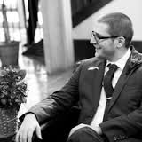
James Harrill
“…Roman slaveholders were neither paternalistic nor racist in the modern sense of the term. Race itself is a modern construct: although there were views about differing ethnicities in antiquity…, there was no so-called scientific theory of skin-coloured race until the nineteenth century.”
Harrill. J, “The Manumission of Slaves in Early Christianity”, p52

Slide 109
Davis Goldenberg
“We first see this… explicit link between skin colour and slavery in Near Eastern sources beginning in the seventh century.…”
“…We note its first appearance in the Christian West as soon as Europe discovered black Africa and began to engage in the slave trade.”
Goldenberg, D “The Curse of Ham” (2003), p. 175, 200

Slide 110
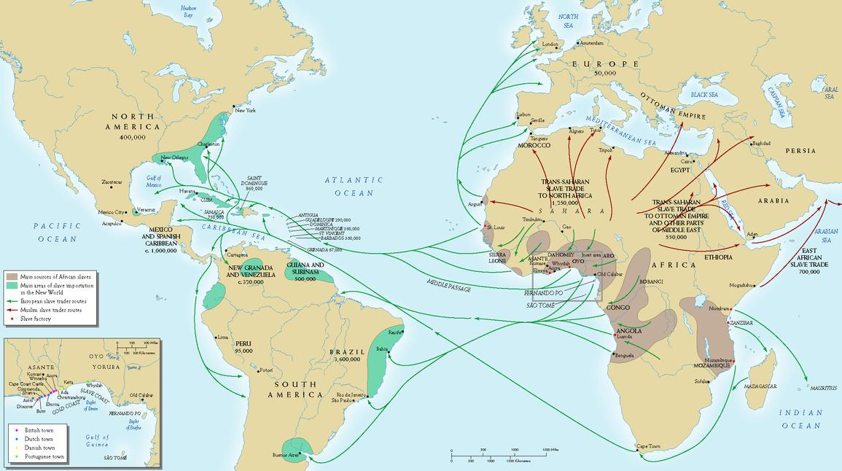
Slave Routes from Africa
Notes:
Accomplished by one of two methods: (1) Revision of genealogy so that North Africans, whilst still sons of Ham, descended through a son other than Canaan, or (2) story retold so that these Sons of Ham were forgiven the sin of their ancester

Slide 111
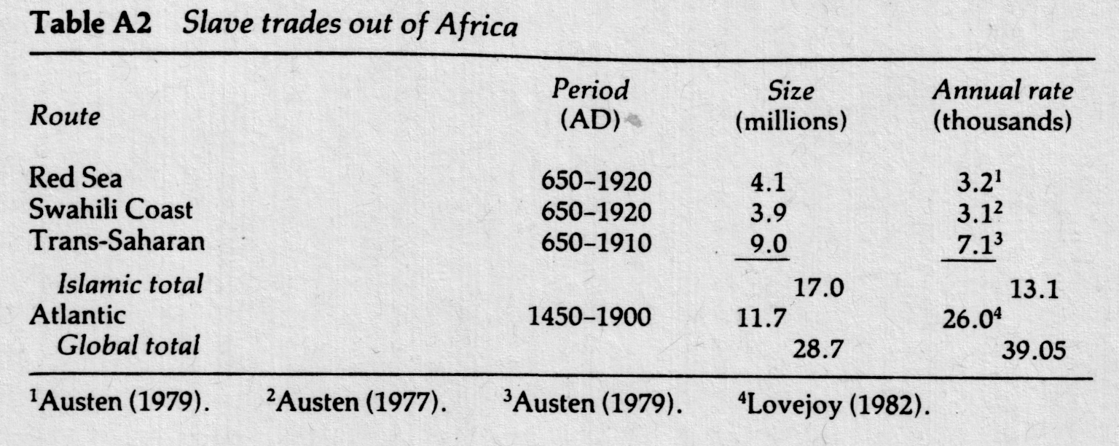
Slaves Leaving Africa
(Note: How many more
Muslim slaves than European slaves)
Austen, African Economic History, (1987, Currey and Heinemann 2003 reprint p. 275)
Notes:
Accomplished by one of two methods: (1) Revision of genealogy so that North Africans, whilst still sons of Ham, descended through a son other than Canaan, or (2) story retold so that these Sons of Ham were forgiven the sin of their ancester

Slide 112
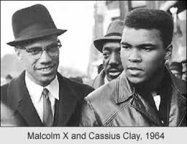
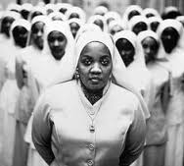
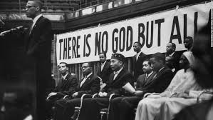
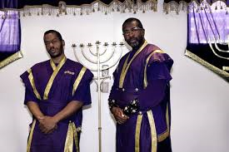
Reaction Against Christianity

Slide 113
Slave Trade / Raid
Comparisons
Islamic Slave Raids in Africa | Trans-Atlantic Slave Trade
2 out of every 3 slaves were women | 2 out of every 3 slaves were men
Mortality rate during transit – 80%-90% | Mortality rate during transit – 10%
Purpose – Mainly sexual exploitation | Purpose – Mainly agricultural work
Few descendants survive | Most descendants survive
Should be over 140m alive today | 11.7m – 100m progeny
Islamic Slave Raids in Europe
From Sicily, Italy to Cornwall, England. Even up to Baltimore, Ireland
Purpose – Galley slaves, labourers and sexual exploitation
16th – 19th C.
1.25m enslaved
Islamic Slave Raids of Americans
American seamen in the Atlantic
1785 – 1793
130 captured
Notes:
1631 almost all the inhabitants of Baltimore, Ireland were captured.

Slide 114
Islamic Slavery in Asia
13th Century +
In South East Asia under Muslim rule, slaves were engaged in “almost every conceivable function”, “Many members of the slave owning merchant class had strong roots in the Islamic world which had a clear body of law on slaves as property.”
Reid cited in Khan, M. A. ‘Islamic Jihad: A legacy of forced conversion, imperialism and slavery’, p299
Notes:
Accomplished by one of two methods: (1) Revision of genealogy so that North Africans, whilst still sons of Ham, descended through a son other than Canaan, or (2) story retold so that these Sons of Ham were forgiven the sin of their ancester

Slide 115
Slavery in the Old Testament

Slide 116
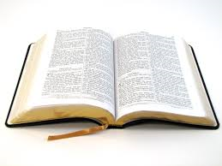
The Polemic Against Christianity
Slavery in the Bible is cruel
Slavery in the Bible is racist
The NT does not abrogate the slavery verses
Notes:
In Bible & Quran
Emotive - (Used in Dawah, Sensitivities & Denials, Calls for reparation, Anger towards the church, Spin off religions narratives and groups in response)

Slide 117
Setting the Scene
Ancient Near East (ANE) v. New World
 | Ancient Near East | New World
Motive | Mainly economic relief of poverty | Mainly economic advantage
Entry | Overwhelmingly voluntary | Overwhelmingly involuntary
Treatment | Generally protected from over-abuse | Frequently mistreated by modern standards, extreme punishments, & little protection
Legal Status | Mix of family member, property, human, & contracting agent. Could do business, borrow money, & buy freedom | Property, to the exclusion of their humanity, & could not own property
Exit | Manumission was rare as quasi-family relationships developed, though some cultures had set pay-off periods | Usually till death
Notes:
ANE (Ancient Near East)

Slide 118
Overview of Slavery in the Bible
Motive
The Promise
Deut. 15:4-5
⁴ But there will be no poor among you; for the Lord will bless you in the land that the Lord your God is giving you for an inheritance to possess— ⁵ if only you will strictly obey the voice of the Lord your God, being careful to do all this commandment that I command you today.

Slide 119
Overview of Slavery in the Bible
2. Entry
God the Realist
Lev. 25:39-40
³⁹ “If your brother becomes poor beside you and sells himself to you, you shall not make him serve as a slave: ⁴⁰ he shall be with you as a hired worker and as a sojourner. He shall serve with you until the year of the jubilee.

Slide 120
Overview of Slavery in the Bible
3. Treatment
Protection from Abuse
Lev. 19:33-34
³³ “When a stranger sojourns with you in your land, you shall not do him wrong. ³⁴ You shall treat the stranger who sojourns with you as the native among you, and you shall love him as yourself, for you were strangers in the land of Egypt: I am the Lord your God

Slide 121
Overview of Slavery in the Bible
3. Treatment
Protection from Abuse
Deut. 23:15-16
¹⁵ “You shall not give up to his master a slave who has escaped from his master to you. ¹⁶ He shall dwell with you, in your midst, in the place that he shall choose within one of your towns, wherever it suits him. You shall not wrong him.

Slide 122
Overview of Slavery in the Bible
4. Legal Status
Slaves were paid wages, owned property, could buy their own slaves, could seek justice from their master…
2 Sam. 19:16-17
¹⁶ And Shimei the son of Gera, the Benjaminite, from Bahurim, hurried to come down with the men of Judah to meet King David. ¹⁷ And with him were a thousand men from Benjamin. And Ziba the servant of the house of Saul, with his fifteen sons and his twenty servants, rushed down to the Jordan before the king
Notes:
Slave wages, slave property, slave justice

Slide 123
Overview of Slavery in the OT
5. Exit
Bought by relatives (Lev 25:49)
Bought by the slave them self, whether or not master agreed (Lev 25:49)
On the 7th (Sabbath) year – with gifts (Ex. 21:2, Deut. 15:12-13)
On the Year of Jubilee – with gifts (Lev. 25:9-)
For some injuries (Deut. 21:26)
Notes:
Slave wages, slave property, slave justice

Slide 124
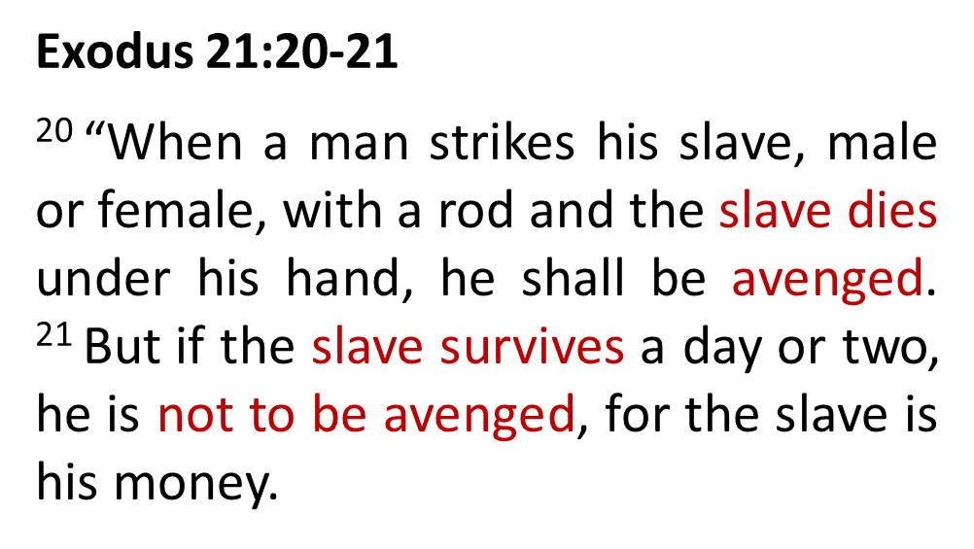
Alleged Cruelty

Slide 125
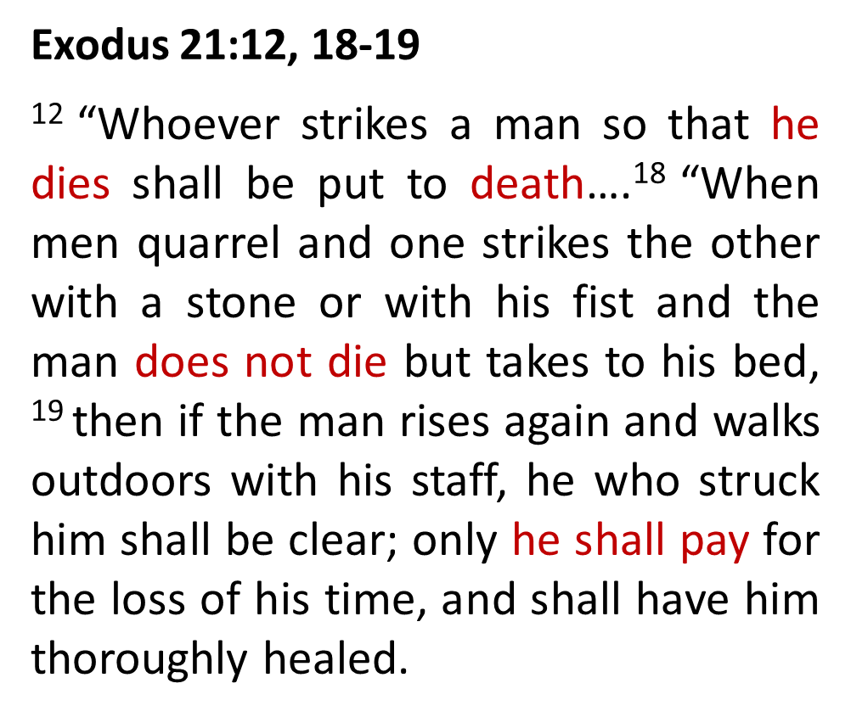
Alleged Cruelty

Slide 126
Alleged Cruelty
Victim | Freeman | Master / Slave
Perpetrator: | “confined to bed” | “cannot get up”
Extent: | Medical attention needed | Likely to be the same
Instrument used: | Stone or fist | Rod
Motive: | Brawl | Disciple
Punitive: | Loss of time | Loss of time
Compensation: | Cost of medical attention | Cost of medical attention
If death: | Execution | Execution
c.f. Q2:178 Retaliation is prescribed for you in the matter of the murdered; the freeman for the freeman, and the slave for the slave, and the female for the female.

Slide 127
Alleged Cruelty
Why is beating by ‘rod’ mentioned?
A method of disciple for the Children of Israel
Court order (Deut. 25:1-3)
Consequence for fools (Prov. 10:13, 26:3)
Rebellious children (Prov. 13:24, 22:15, 23:13)

Slide 128
Alleged Cruelty
Ex. 21:7-11
⁷ “When a man sells his daughter as a slave, she shall not go out as the male slaves do. ⁸ If she does not please her master, who has designated her^{[a]} for himself, then he shall let her be redeemed. He shall have no right to sell her to a foreign people, since he has broken faith with her. ⁹ If he designates her for his son, he shall deal with her as with a daughter. ¹⁰ If he takes another wife to himself, he shall not diminish her food, her clothing, or her marital rights. ¹¹ And if he does not do these three things for her, she shall go out for nothing, without payment of money.
Notes:
Slave wages, slave property, slave justice

Slide 129
Alleged Cruelty
Deut. 21:10-14
¹⁰ “When you go out to war against your enemies, and the Lord your God gives them into your hand and you take them captive, ¹¹ and you see among the captives a beautiful woman, and you desire to take her to be your wife, ¹² and you bring her home to your house, she shall shave her head and pare her nails. ¹³ And she shall take off the clothes in which she was captured and shall remain in your house and lament her father and her mother a full month. After that you may go in to her and be her husband, and she shall be your wife. ¹⁴ But if you no longer delight in her, you shall let her go where she wants. But you shall not sell her for money, nor shall you treat her as a slave, since you have humiliated her.
Notes:
Slave wages, slave property, slave justice

Slide 130
Alleged Cruelty
Counter Cultural
"Throughout the ancient Mediterranean world, captive women of vanquished peoples were assumed to be the due sexual prerogative of the victors. This law exceptionally seeks to provide for the human rights of the woman who falls into this predicament...the verb 'inah is also sometimes used for rape, and its employment here stringently suggests that the sexual exploitation of a captive woman, even in a legally sanctioned arrangement of concubinage, is equivalent to rape" [The Five Books of Moses: A Translation with Commentary, Robert Alter, Norton:2004, at Deut 21.10,14]

Slide 131
Exodus 21:16
“Whoever steals a man and sells him, and anyone found in possession of him, shall be put to death.”

Slide 132
Slavery in the New Testament

Slide 133
Galatians 3:27-28
²⁷ For as many of you as were baptized into Christ have put on Christ. ²⁸ There is neither Jew nor Greek, there is neither slave nor free, there is no male and female, for you are all one in Christ Jesus.

Slide 134
1 Timothy 1:8-11
⁸ Now we know that the law is good, if one uses it lawfully, ⁹ understanding this, that the law is not laid down for the just but for the lawless and disobedient, for the ungodly and sinners, for the unholy and profane, for those who strike their fathers and mothers, for murderers, ¹⁰ the sexually immoral, men who practise homosexuality, enslavers, liars, perjurers, and whatever else is contrary to sound doctrine, ¹¹ in accordance with the gospel of the glory of the blessed God with which I have been entrusted.

Slide 135
Philemon 1
⁸ Accordingly, though I am bold enough in Christ to command you to do what is required, ⁹ yet for love's sake I prefer to appeal to you—I, Paul, an old man and now a prisoner also for Christ Jesus— ¹⁰ I appeal to you for my child, Onesimus, whose father I became in my imprisonment….
¹⁵ For this perhaps is why he was parted from you for a while, that you might have him back for ever, ¹⁶ no longer as a slave but more than a slave, as a beloved brother…
¹⁷ So if you consider me your partner, receive him as you would receive me.
²¹ Confident of your obedience, I write to you, knowing that you will do even more than I say.

Slide 136
Slavery in the Bible
Consequence of the fall (Genesis 1:28)
All experience slavery to sin (Romans 6)
God is no respecter of persons (Acts 10:34, Romans 2:11):
Joseph, Children of Israel, Daniel, Shadrach, Misheck, Abed-Nego, Esther, Nehemiah, Ezekiel, Zerubbabel, Ezra
Great example: Children of Israel in Egypt (Exodus 12)
Greatest example: Jesus (Philippians 2:7)
Hagar or Sarah, Ismail or Isaac, Law or Promise
Notes:
ANE (Ancient Near East)

Slide 137
Comparison
Islam
Christianity
Slave of Allah
Child of God
Through
Christ
Slave to sin
Slave of Allah
Made in God’s image
Notes:
ANE (Ancient Near East)

Slide 139
Further Comparisons
Christianity | Islam
Narrative – Slavery to Freedom | Narrative – Slavery to Slavery
Voluntary | Involuntary
Freedom in YHWH was always the plan | Slave to Allah always the plan
Jesus did not trade or own slaves | Muhammad traded and owned slaves
Jesus set the world free | Muhammad bought more slaves than he “freed”
Our freedom was costly | Freedom is a mere monetary value
Colour not important | Colour frequently mentioned
God Himself fought for our freedom | Muhammad fought to capture slaves

Slide 140
Conclusion
Galatians 5:1
“For freedom Christ has set us free; stand firm therefore, and do not submit again to a yoke of slavery.”
Notes:
ANE (Ancient Near East)

